Slide 1


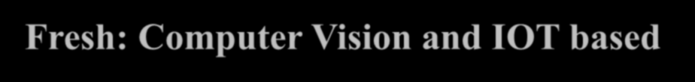









e-Fresh: Computer Vision and IOT based system for food industry
Group No: 10
Akshata Gawas 18104039
Krishita Tolia 18104021
Siddhesh Gaikwad 18104069
Guided by
Prof. Kaushiki Upadhyaya Co Guide
Prof. Sonal Jain

Slide 2
Contents
Introduction
Objectives
Problem Definition
Technological Stack
Review Suggestions (Given in Last meeting)
Proposed System Architecture/Working
Prototype Design Demonstration
Implementation Status
Status of Paper Draft & Targeted Conference

Slide 3

1. Introduction
Problem Identified:
Detection of defected fruits and the classification of fresh and rotten fruits represent one of the major challenges in the agricultural fields. Rotten fruits may cause damage to the other fresh fruits if not classified properly. Traditionally this classification is done by men, which was labour-intensive, time taking, and not efficient procedure. Thus, factories need human intervention for segregation of fruits
Solution Proposed :
Hence, we need an automated system which can reduce the efforts of humans and time of production. Our system will automatically do that with help of CNN classification Algorithm. The proposed idea will create a segregation model which would need no human intervention for classifying and segregating fruits.

Slide 4

2. Objectives
To create a model to classify fresh and rotten fruits.
To preprocess images before sending them to the model.
To achieve efficient model considering the cost.
To train a model with high accuracy.
To develop a hardware system considering the Industry 4.0 standards.
To program NodeMCU for collecting and sending images to server.
To program NodeMCU for segregation.
To host data analysis dashboard on AWS cloud.

Slide 5
3. Problem Definition
To accurately classify fruits using Deep Learning algorithm i.e. CNN, segregate them with the help of required hardware considering the Industry 4.0 standards and hosting a dashboard displaying the data visualization.

Slide 6

4. Technology Stack
Hardware Requirements:
NodeMCU ESP8266
Cameras: 3
Motor/ Rotator(for conveyor belt)
Wi-Fi module
⚫Flaps
⚫Servo-motor
⚫Alcohol Sensor(MQ3), Methane Sensor(MQ4) Software Requirements:
⚫Google Colab
⚫Tensorflow, Keras, Pandas, Numpy.
⚫AWS Cloud.

Slide 7
5. Review Suggestions (Given in Last meeting)
Changing project name: Done
Increasing Dataset: Done
Deciding Architecture: Done
Finalizing Sensors: Done
Finding parameters for Data Analysis: Done

Slide 8
Parameters for Data Visualization
Colour
Size
Ethanol level
Methane level
Texture
Production Details

Slide 9
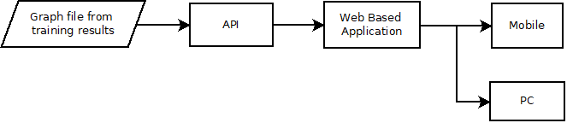
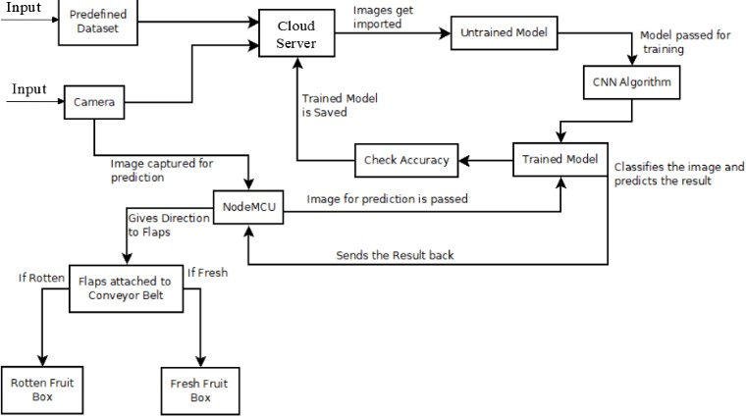
6. Block Diagram of Working

Slide 10
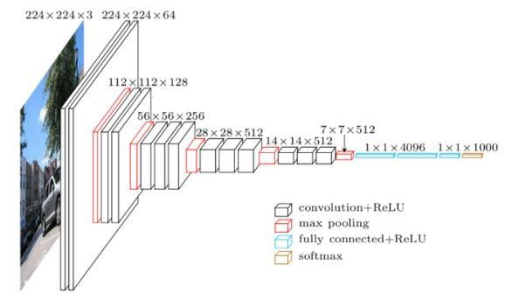
7. Classification Algorithm
Convolution Neural Network

Slide 11

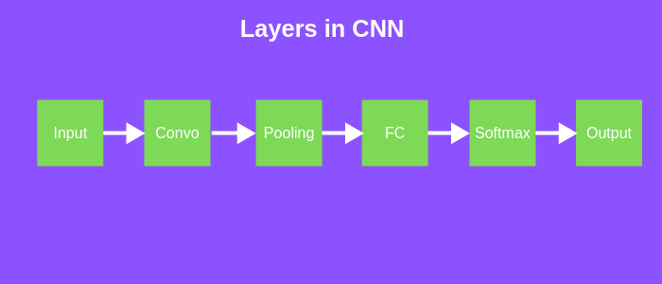
8. Layers of CNN

Slide 12


9. Architecture of CNN

Slide 13
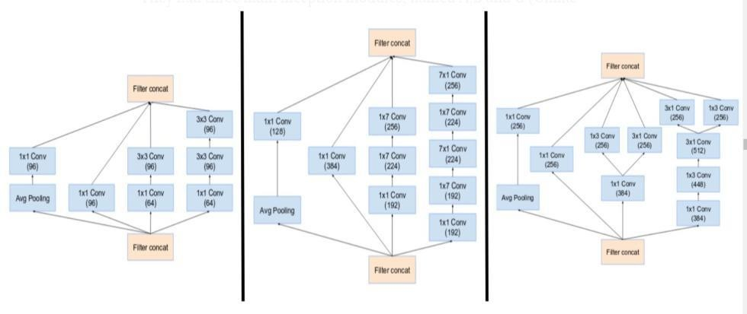
10. InceptionV3
Block A
Block B
Block C

Slide 14
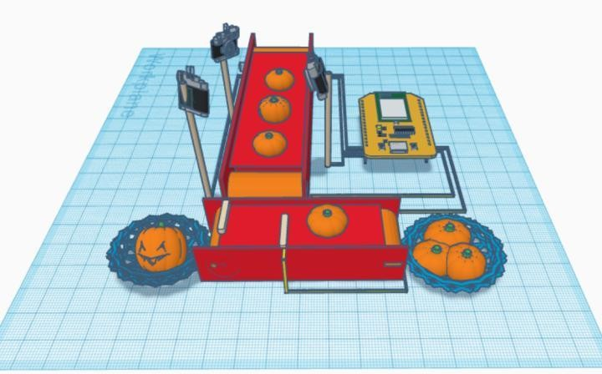
11. Demonstration Model

Slide 15
12. Implementation Status
Successfully implemented CNN model with Inception V3 architecture.
Achieved accuracy of 98.5% .
Finalized the architecture required but might need some changes ,since we are in testing phase.

Slide 16


13. Status of Paper Draft & Targeted Conference
Status of paper: Completed writing Abstract and Introduction. Listed all the necessary keywords.
Targeted Conference:
IEEE 2021 Conference on Advances in Computing, Communication and Control - (20th September)
International Conference On Big Data, Machine Learning and Applications - (25th September)

Slide 17
Thank You...!!

